Slide 1
HIDING DATA USING STEGANOGRAPHY
CAPSTONE PROJECT
PRESENTED BY
STUDENT NAME
COLLEGE NAME & DEPT
: MUHAMMED UBADAH
: MUHAMMED UBADAH
: NSAKCET (CSE)

Slide 2
OUTLINE
Problem Statement
Technology used
Wow factor
End users
Result
Conclusion
Git-hub Link
Future scope

Slide 3
Problem Statement
In today's digital age, the security of sensitive information during transmission is paramount. Traditional encryption methods, while effective, can draw unwanted attention, as the presence of encrypted data is easily noticeable. This project addresses the challenge of concealing the very existence of confidential data by embedding it within innocuous digital images, ensuring both the secrecy and security of the information.

Slide 4
Technology used
Programming Language: Python
Cryptography Library: PyCryptodome for AES encryption and decryption
Other Libraries: OS, Base64
Image Processing: Pillow (PIL Fork) for handling image files
Steganography Technique: Least Significant Bit (LSB) method for embedding encrypted data into images
Executable Creation: PyInstaller for packaging the Python script into a standalone .exe application
Framework: TKinker

Slide 5
Technology used
Minimum System Requirements:
Operating System: Windows 10 / macOS 11 / Linux (Ubuntu 20.04)
Processor (CPU): Intel Core i3 (8th Gen) / AMD Ryzen 3
RAM: 4 GB
Storage: 10 GB free space
Graphics (GPU): Integrated Graphics (Intel UHD 620 / AMD Vega 3)
Internet: Required for online features
Other: .NET Framework 4.8 / Python 3.10

Slide 6
Wow factors
Dual-Layer Security: Combining AES encryption with LSB steganography ensures that even if the steganographic layer is detected, the underlying data remains encrypted and secure.
User-Friendly Interface: The application offers a straightforward GUI, allowing users to easily encrypt and embed their messages without requiring technical expertise.
Versatility: Supports both AES-128 and AES-256 (Working on it) encryption standards, providing flexibility based on security requirements.
Portability: The standalone .exe format ensures that users can run the application on Windows systems without needing to install additional dependencies.

Slide 7
End users
Journalists and Whistleblowers: Individuals needing to transmit sensitive information without drawing attention.
Corporate Professionals: Businesses aiming to protect confidential communications and intellectual property.
General Public: Anyone interested in safeguarding personal data, such as private messages or documents, during digital transmission.

Slide 8
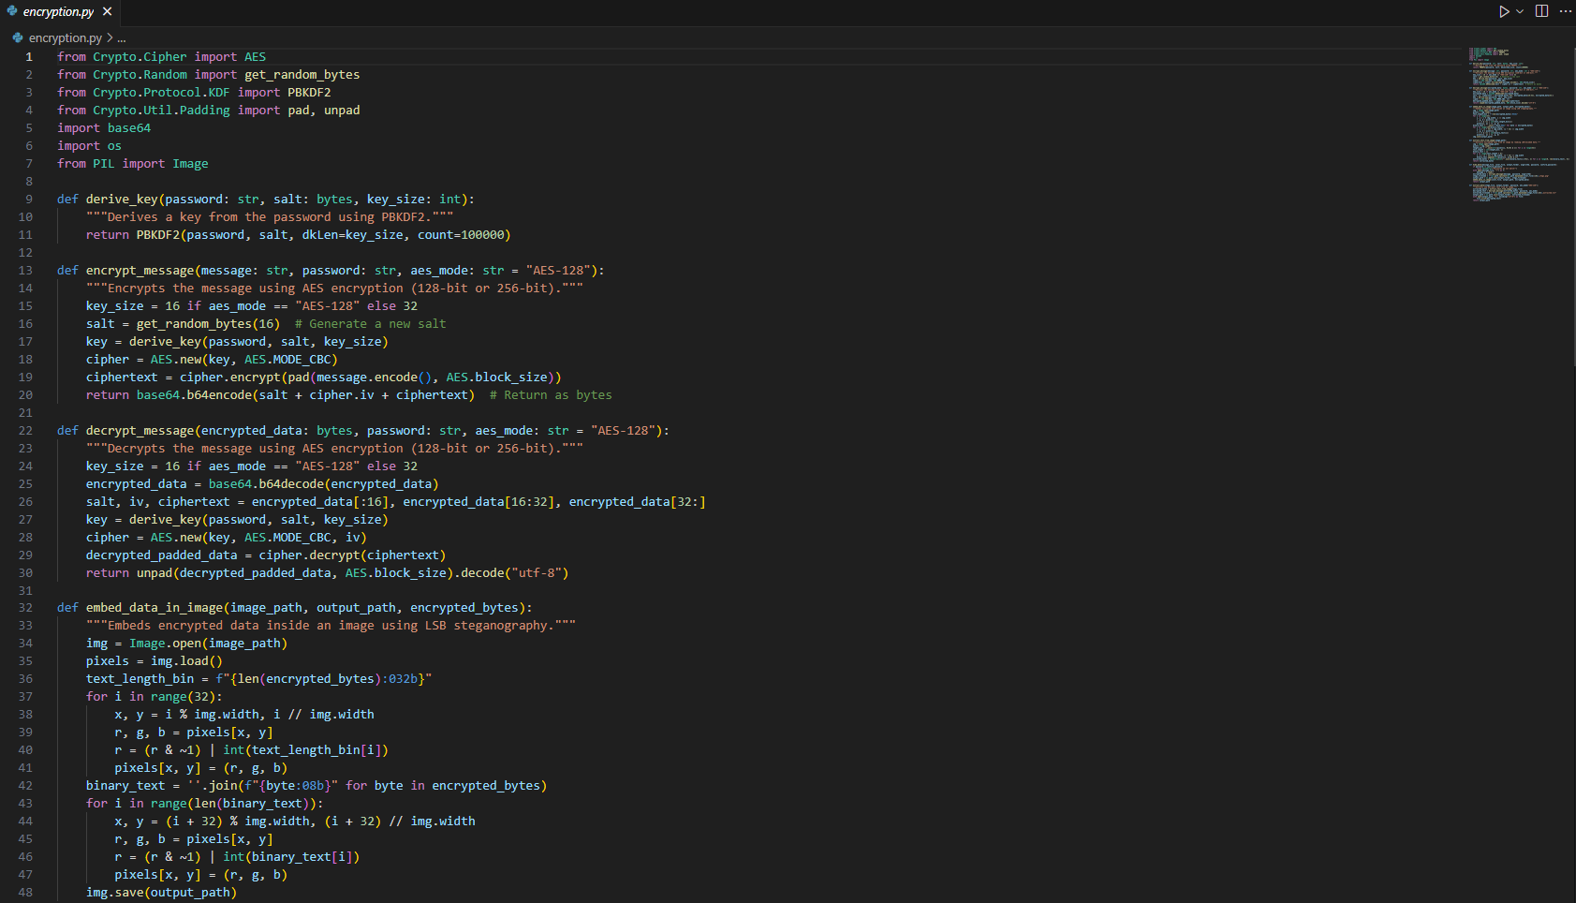
Results
The Code: Part 1

Slide 9
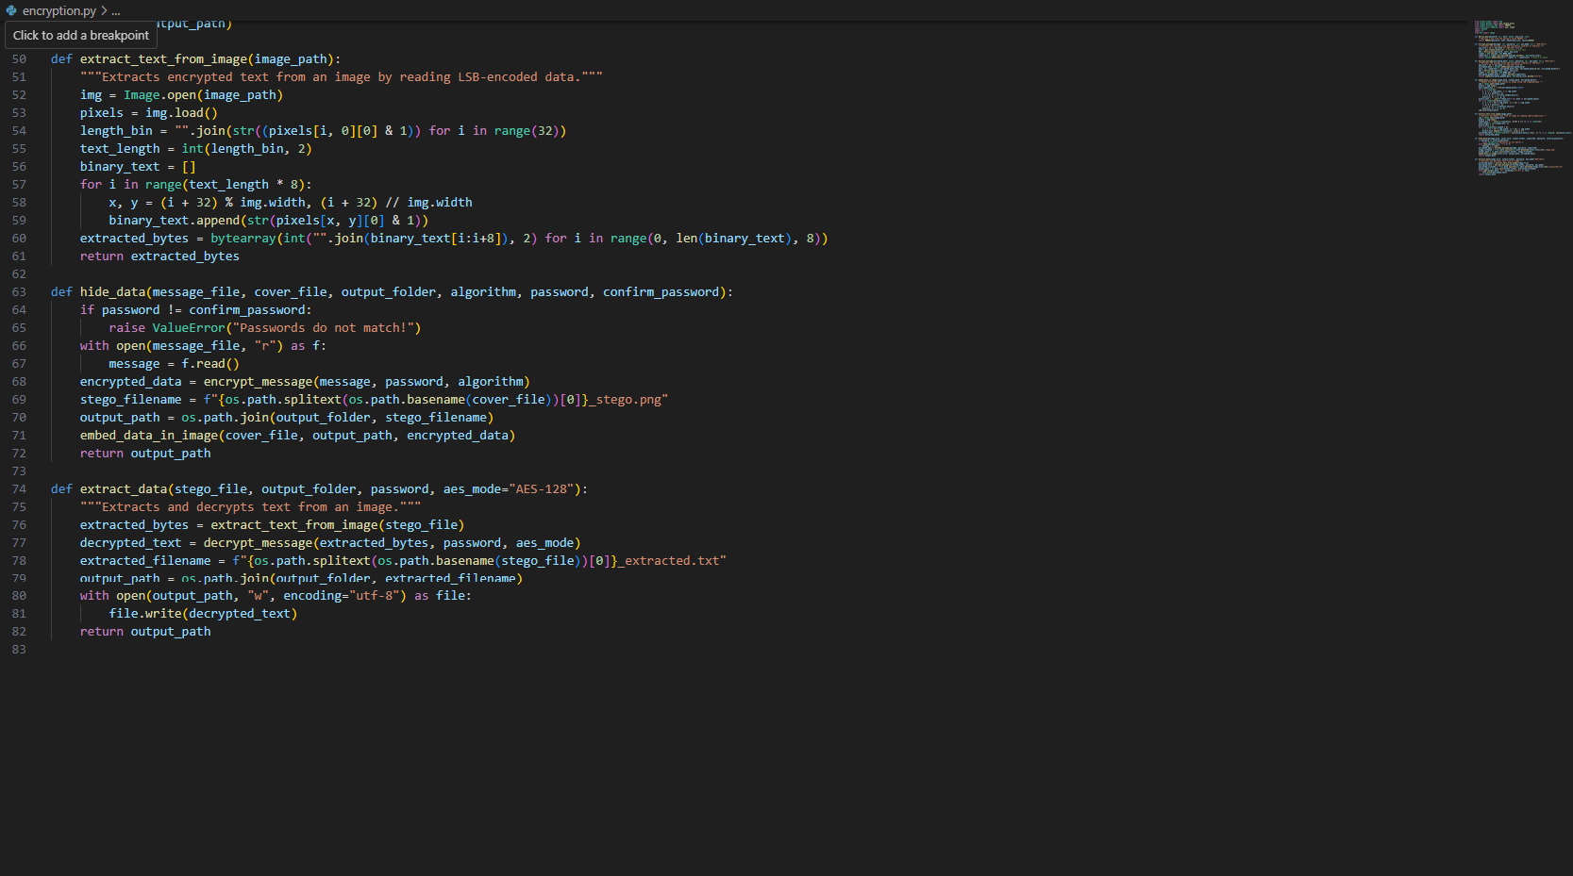
Results
The Code: Part 2

Slide 10
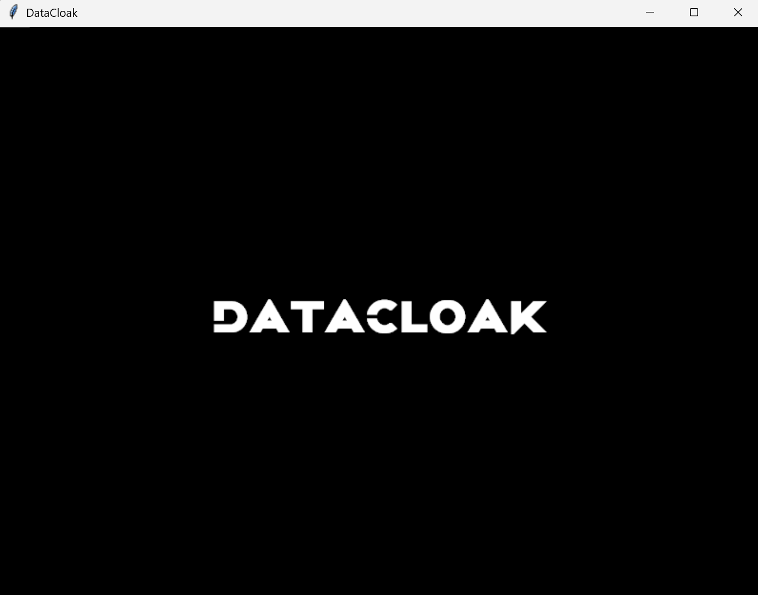
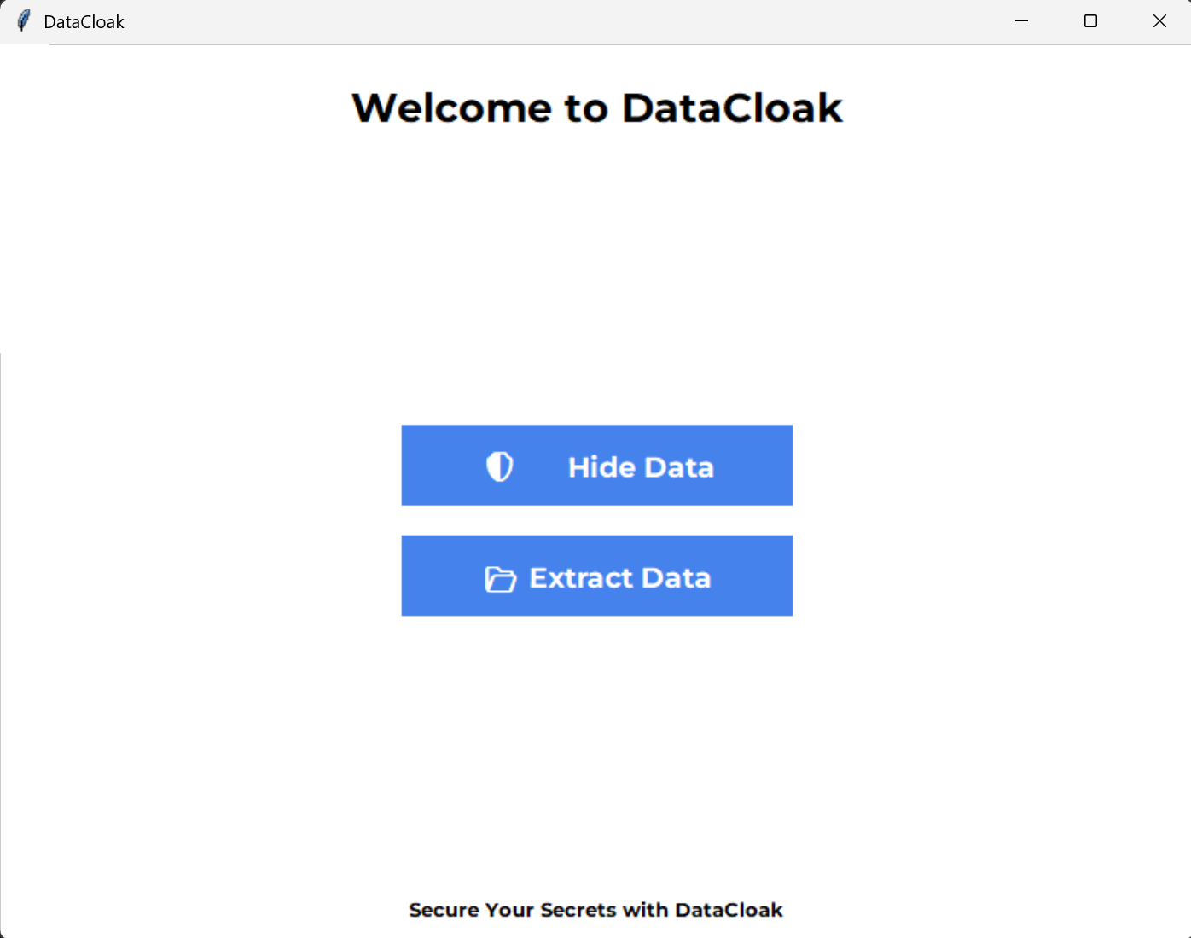
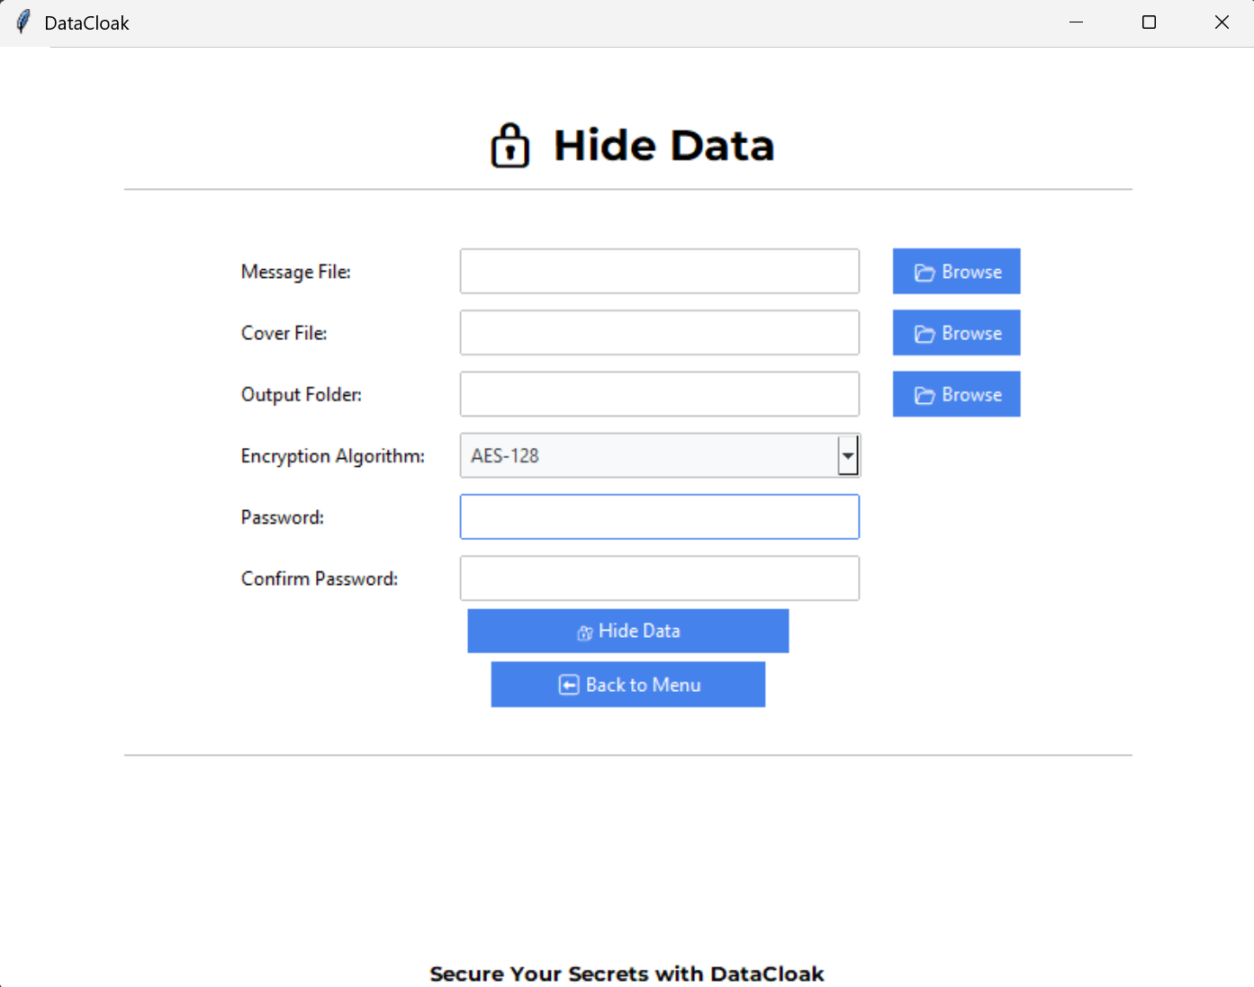
Results
The App screen Previews
Fig 1: Splash
Fig 2: Main Menu
Fig 3: Hide Data Screen

Slide 11
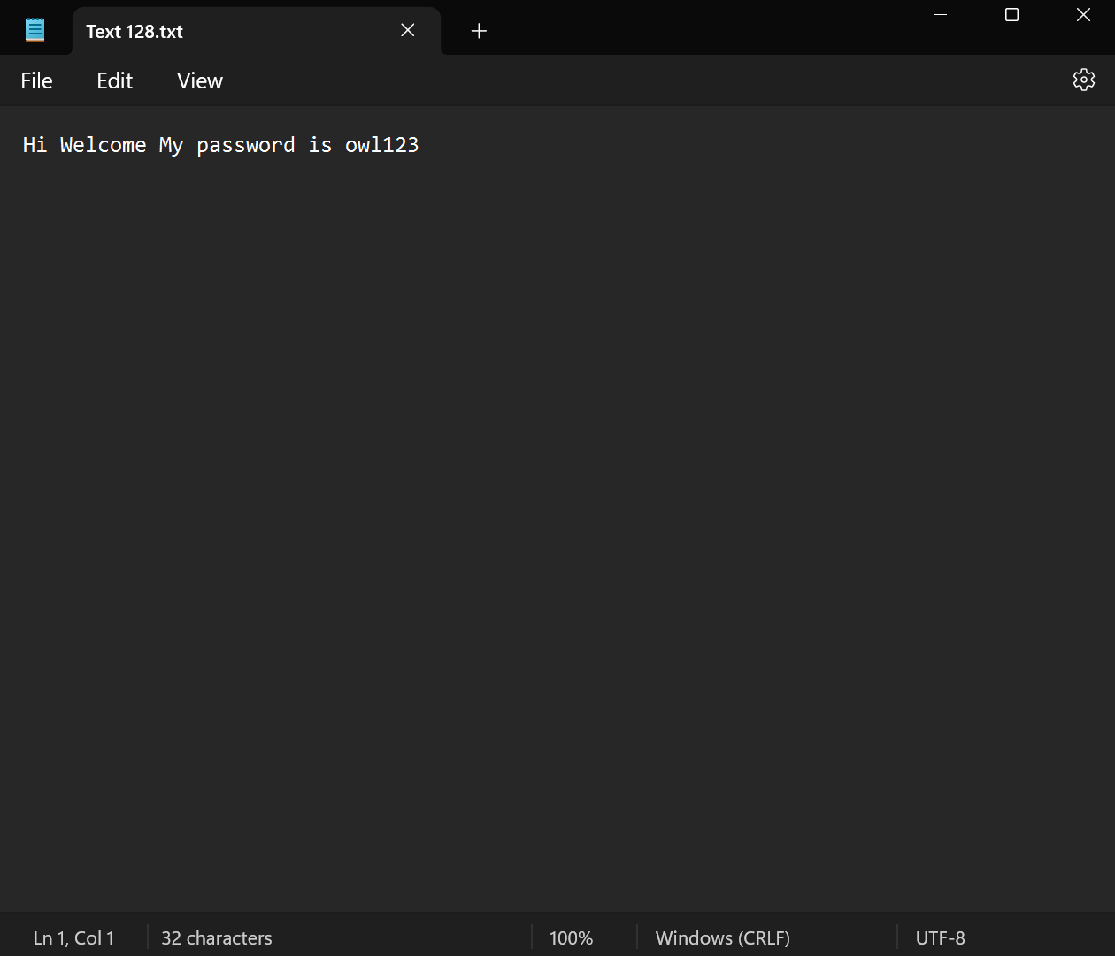
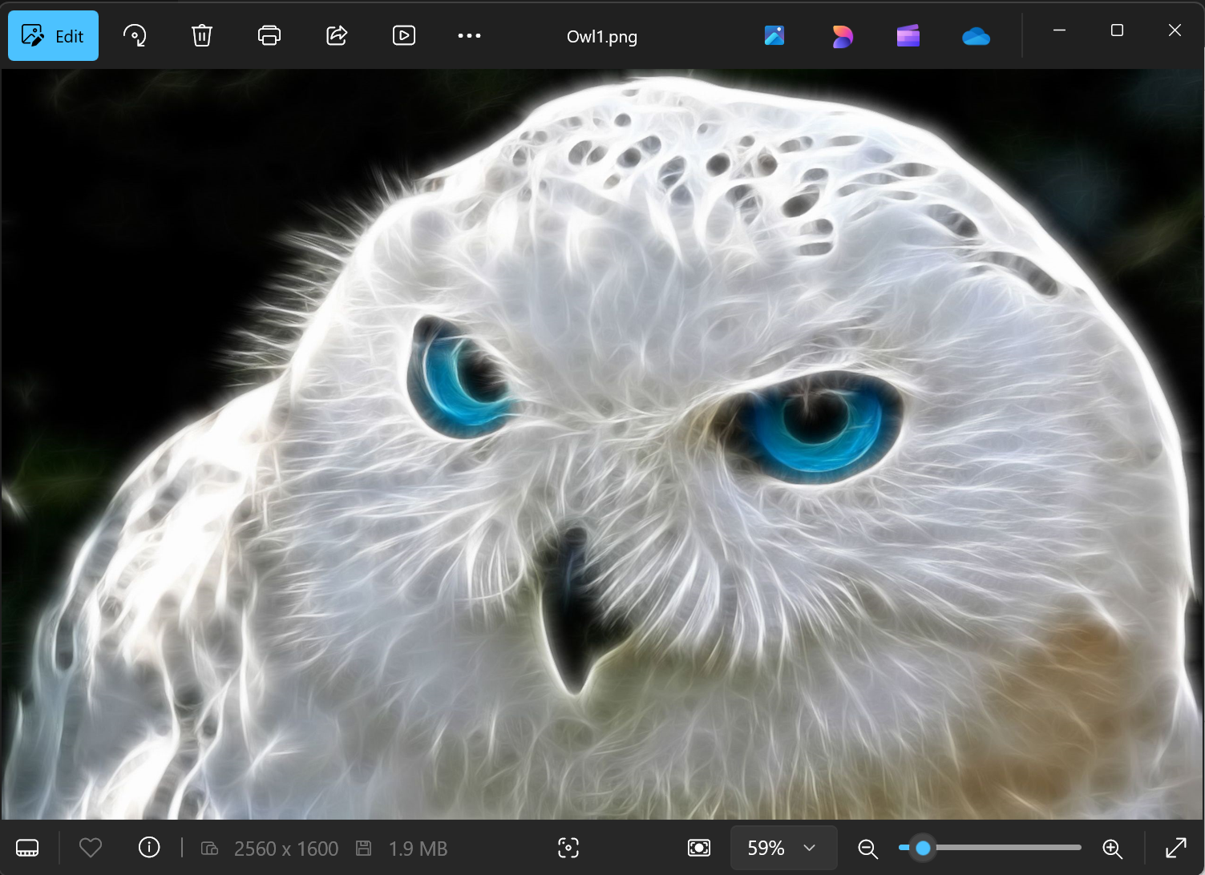

Results
The App screen Previews
Fig 4: Test Data
Fig 5: Test Image
Fig 6: Encrypting Data

Slide 12
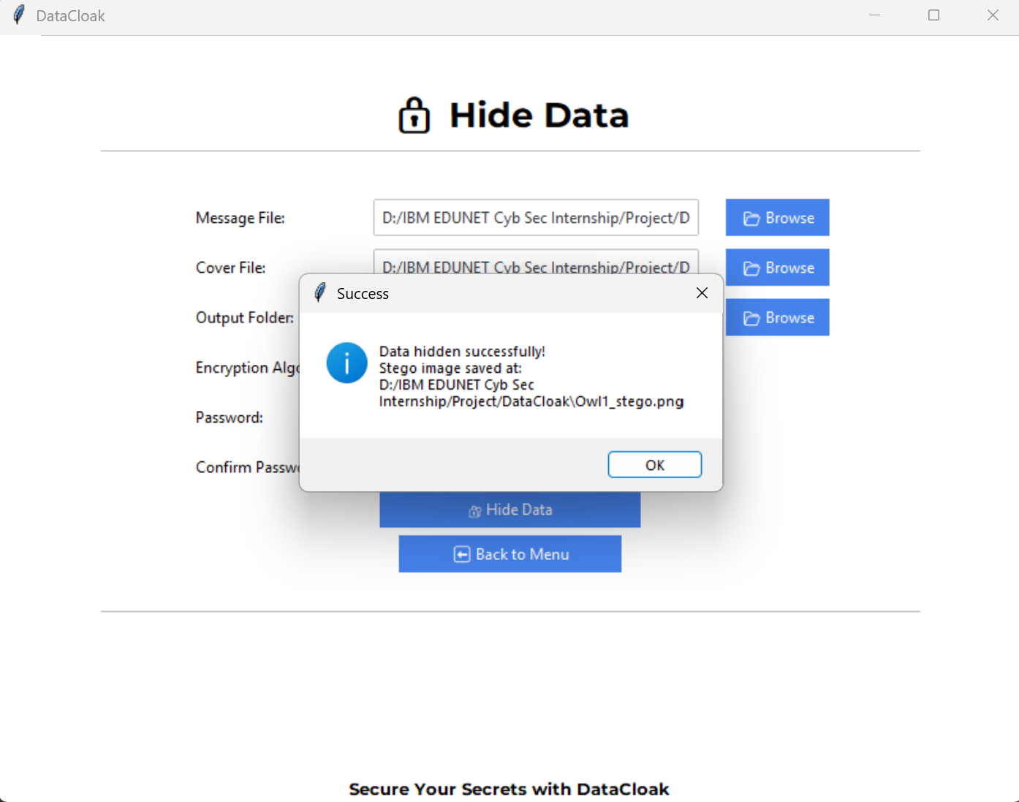
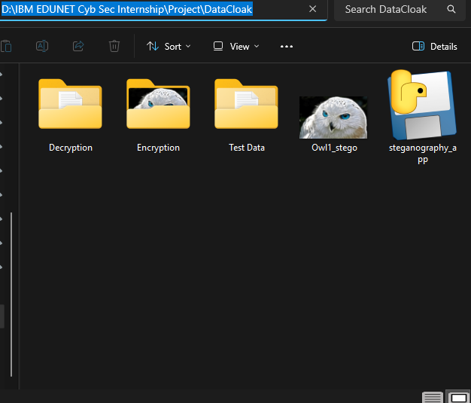
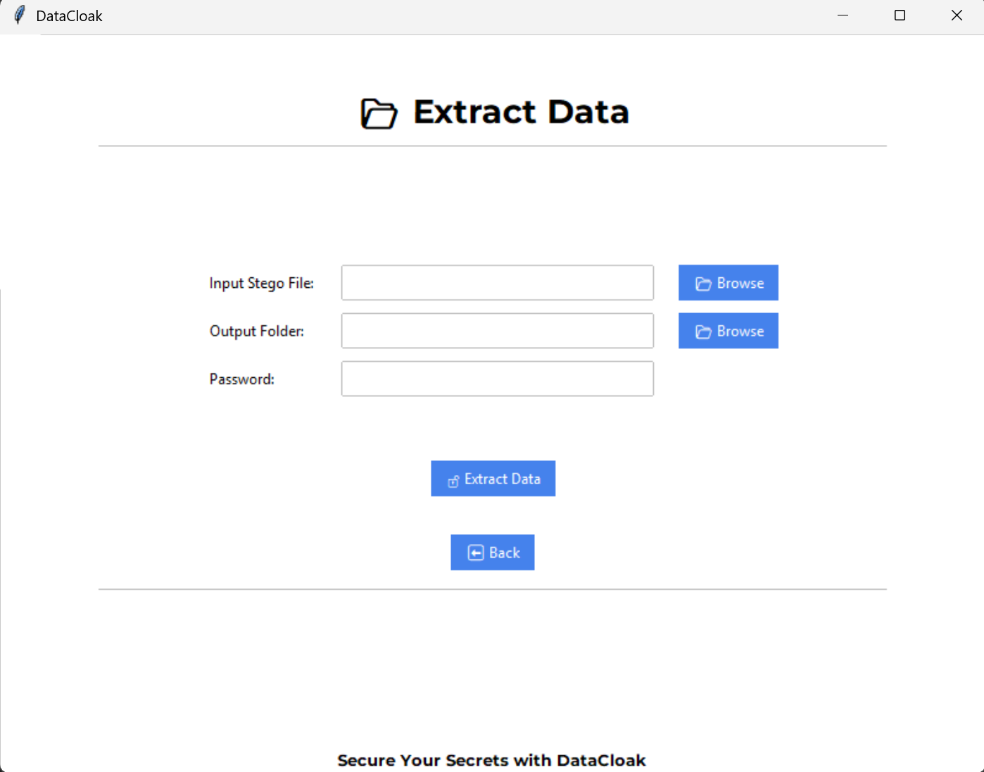
Results
The App screen Previews
Fig 7: Encryption Confirmation
Fig 8: Stego Image Location
Fig 9: Extract Data Screen

Slide 13
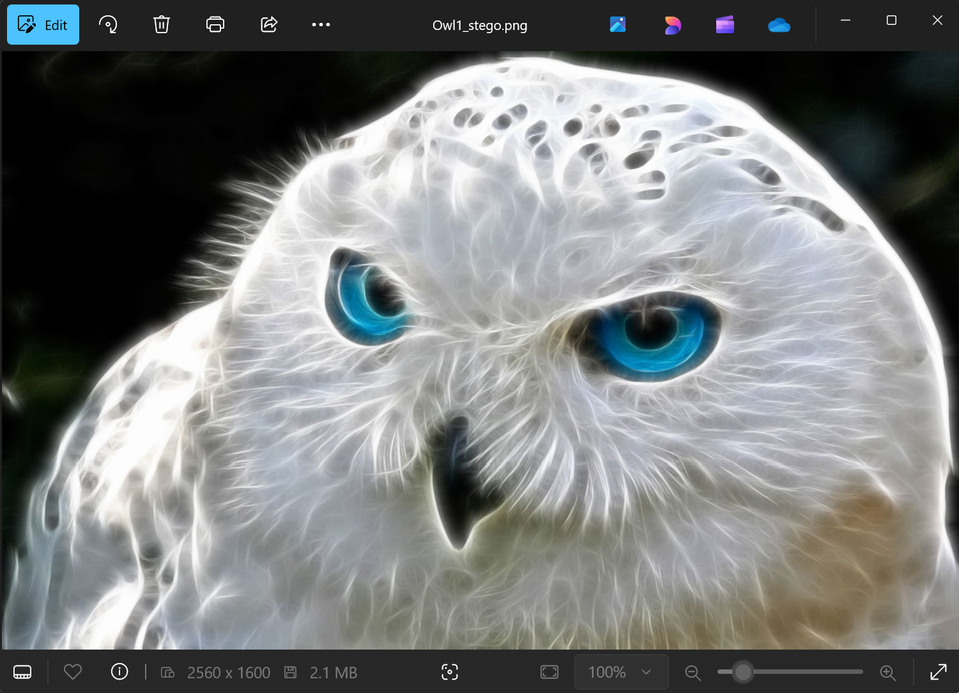
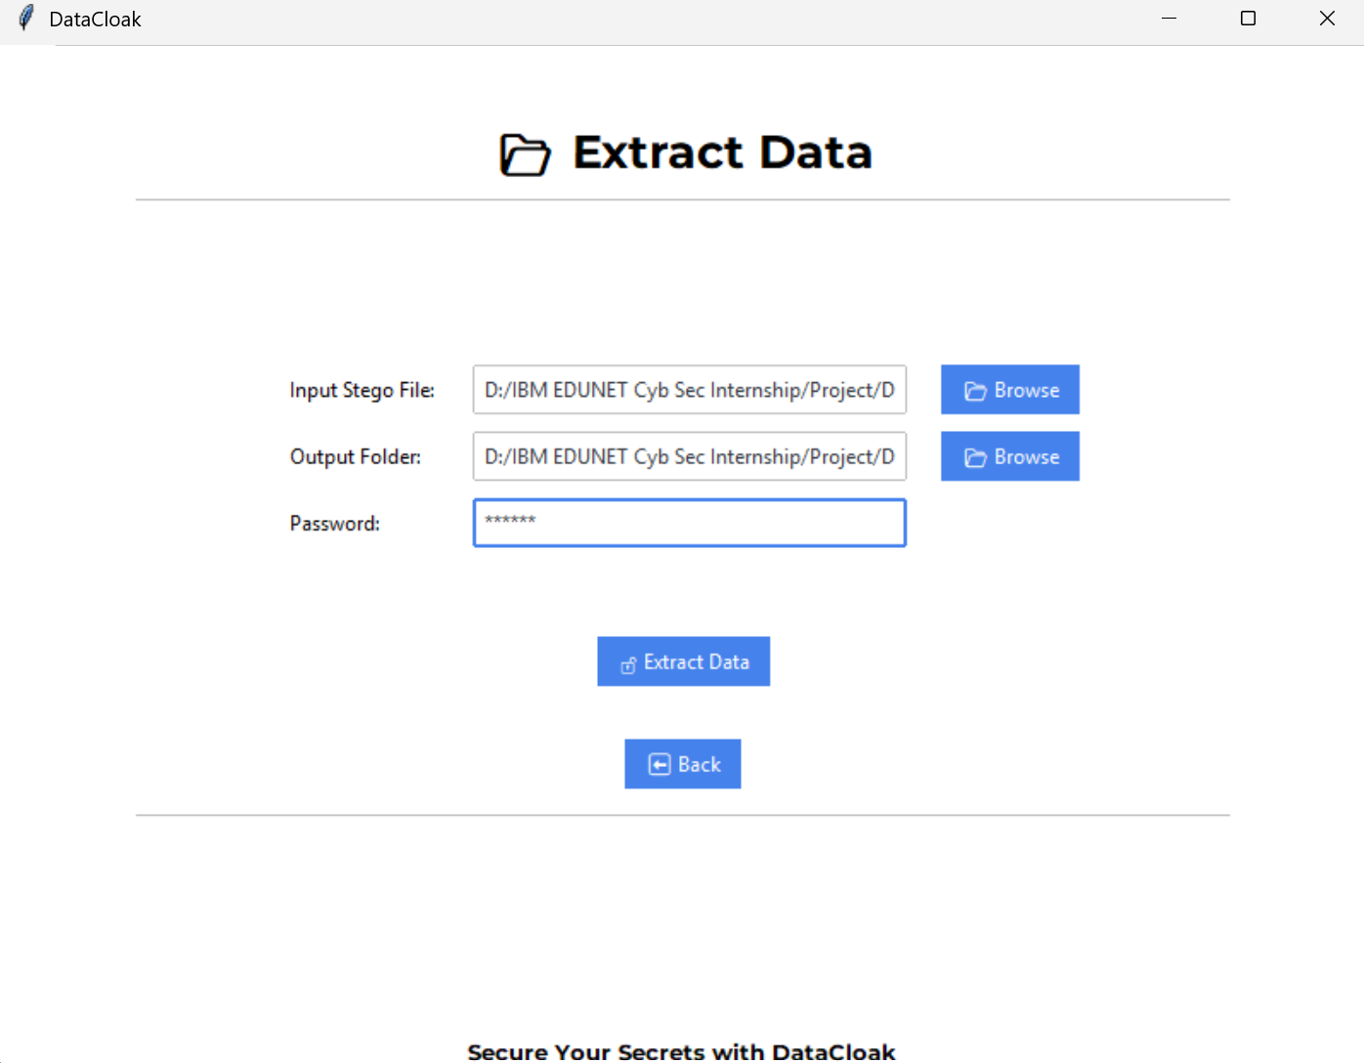
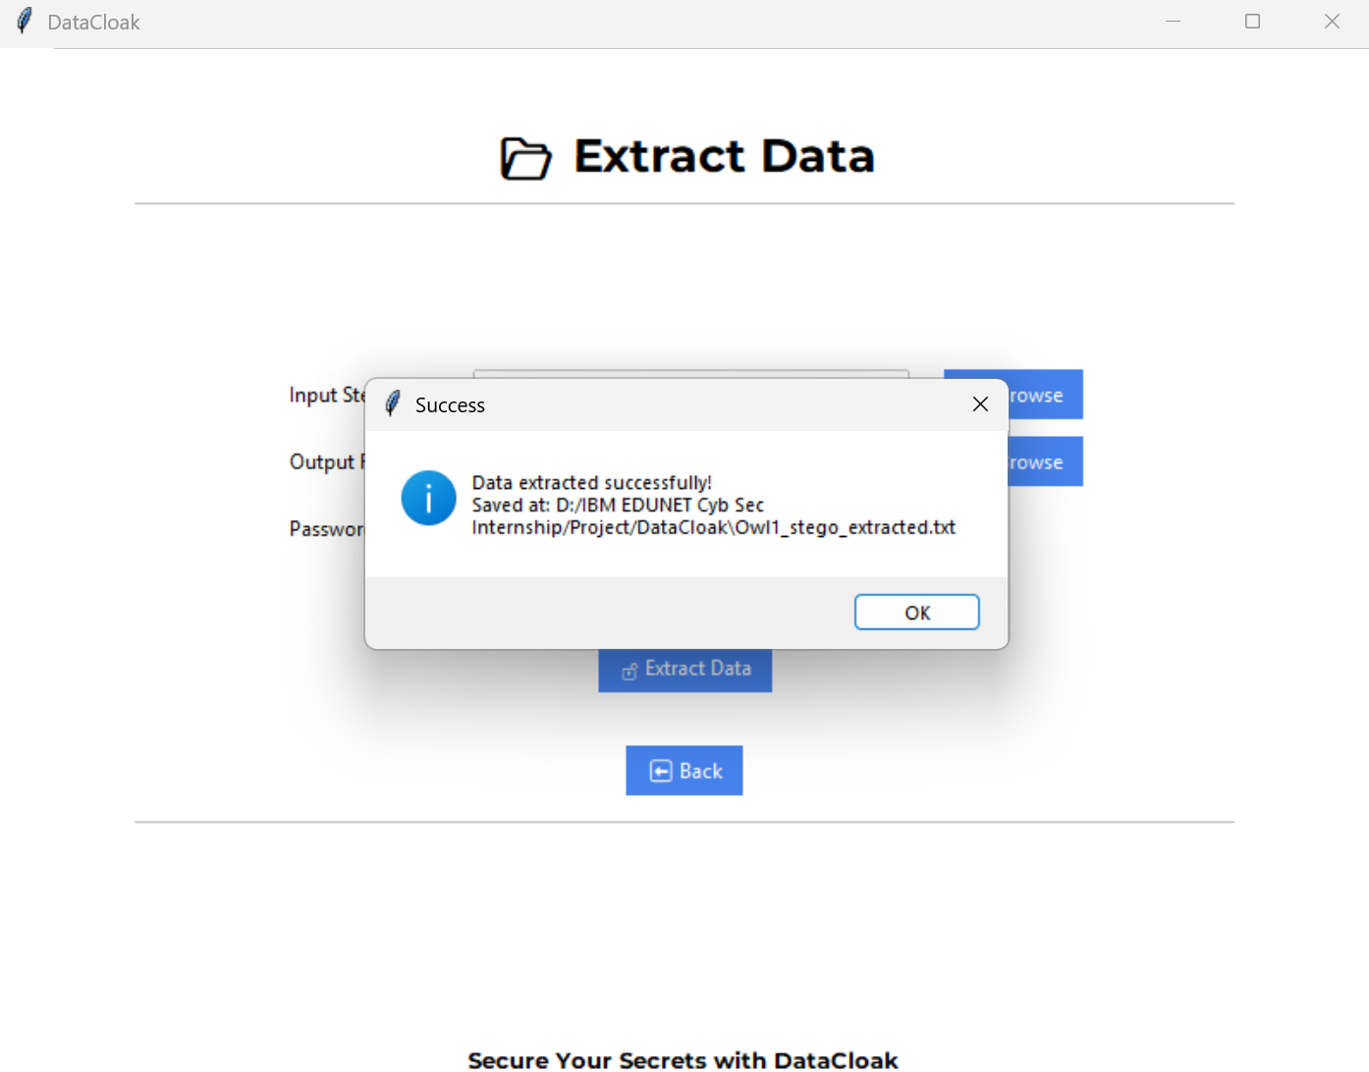
Results
The App screen Previews
Fig 10: Stego Image
Fig 11: Decrypting Data
Fig 12: Decryption Confirmation

Slide 14
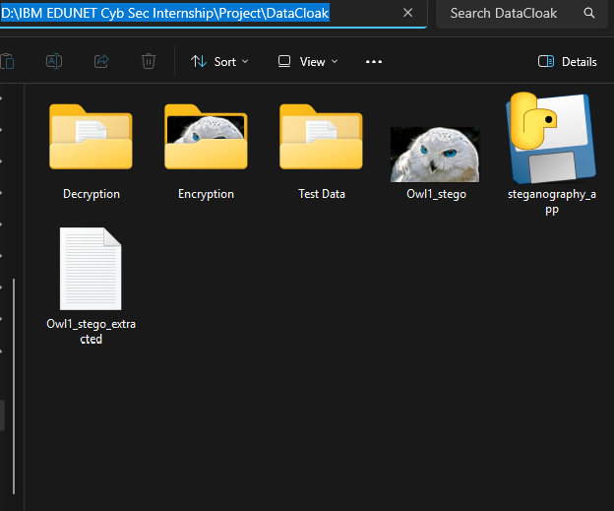
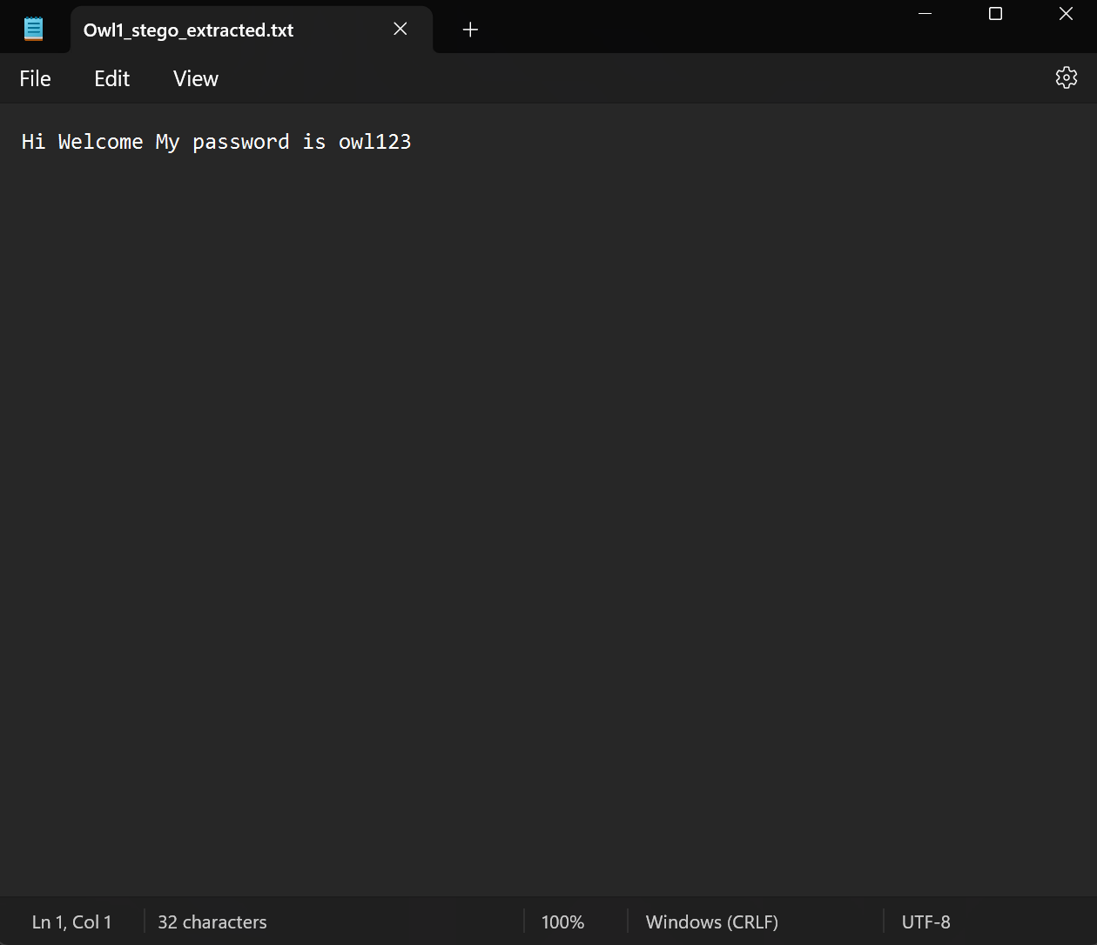
Results
The App screen Previews
Fig 13: Extracted Data Location
Fig 14: Extracted Data

Slide 15
Conclusion
This project successfully demonstrates a robust method for secure communication by integrating encryption and steganography. By concealing encrypted data within images, it ensures that sensitive information remains hidden in plain sight, offering an additional layer of security beyond traditional encryption methods.

Slide 16
GitHub Link
Make sure that there should be readme file

Slide 17
Future scope
Enhanced Steganography Techniques: Exploring more advanced methods, such as adaptive steganography, to further minimize the detectability of hidden data.
Cross-Platform Compatibility: Extending support to other operating systems like macOS and Linux to reach a broader user base.
Automated Key Management: Implementing secure key exchange protocols to streamline the encryption/decryption process for users.
Real-Time Communication Integration: Incorporating the technology into messaging platforms to enable real-time, secure, and covert communication channels.
By advancing these areas, the application can offer even more robust and versatile solutions for secure and hidden data transmission.

Slide 18
THANK YOU

